Slide 1
Making this resource work for you
Prior to teaching this lesson, please refer to the ‘Unit Overview and Planning Document’.
Further guidance on planning Science Mastery lessons can be found in the detailed planning guidance document.
Refer to the ‘notes’ section on each slide for useful information, including suggested expositions, pedagogical content knowledge, suggested questions, answers and more. Consider using presenter mode so you can see this guidance throughout the lesson.
The introduction slides can be adapted to suit your teaching style and the needs of your class.
Before the lesson, adapt the fix-it slide to address any misconceptions identified in the previous lesson’s exit ticket.
Choose from the suggested activities to suit your class. The intention is not that you complete all of these, but that you select those which ones are most appropriate for your students. It may be appropriate to further adapt activities for your students.
These lessons are designed to occupy approximately 1 hour. To adapt for a shorter or longer lesson duration we advise you to adapt the activity section accordingly.
Please consider using the final slide to send feedback about this lesson or examples of PowerPoints that you have adapted to our design team. Your feedback is used to improve Science Mastery for all of our teachers and students. We appreciate all suggestions and comments.
Thank you for reading!
The Science Mastery Team

Slide 2
Acids, Alkalis and Neutralisation
Answer the questions below.
State the chemical formula for hydrochloric acid.
State the general equation for the reaction between an acid and an alkali.
Name the salt that would be produced from a reaction between calcium hydroxide and sulfuric acid.
Calculate the M_{r} of sodium hydroxide (NaOH). Na=23, O=16, H=1
Sodium hydroxide is an alkali. What colour would Universal Indicator turn when added to sodium hydroxide solution?
HCl
Acid + alkali → salt + water
Calcium sulfate
23+16+1=40
Purple/blue
Notes:
Big idea: Reactions rearrange matter
Foundation: State the chemical formula for sulfuric acid.
Stretch: Explain the difference between an alkali and a base.
Answers:
Foundation: H₂SO₄
Stretch: A base is any substance that can neutralise an acid, with a pH of 8-14. Alkalis are soluble bases.

Slide 3
Acids, Alkali and Neutralisation
Do Now:
State the chemical formula for hydrochloric acid.
State the general equation for the reaction between an acid and an alkali.
Name the salt that would be produced from a reaction between calcium hydroxide and sulfuric acid.
Calculate the M_{r} of sodium hydroxide (NaOH). Na=23, O=16, H=1
Sodium hydroxide is an alkali. What colour would Universal Indicator turn when added to sodium hydroxide solution?
Drill:
State the pH of a neutral solution.
A substance has a pH of 4.7. It is an acid or a base?
Is a pH of 4.7 likely to be detected from Universal Indicator or a pH probe?
Notes:
Drill answers:
7
Acid
pH probe - UI could not give a decimal place

Slide 4
Acids, Alkalis and Neutralisation
Read Now:
The pH scale is a measure of the acidity or alkalinity of a solution. It measures from 0-14, where pH 7 is neutral, pH values lower than 7 are acidic and pH values greater than 7 are alkaline. The pH scale is an unusual scale in that a one point increase is equivalent to a ten-fold increase or decrease in acidity or alkalinity. For example, pH 2 is 10 times more acidic than pH 3. Litmus paper can be used to show whether a substance is acidic or alkaline but cannot give a pH value. pH values can be measured using Universal Indicator or a pH probe. Universal Indicator turns different colours in acidic and alkaline solutions which can be matched to a colour chart. A pH probe gives a more precise measurement, as it can give a value with a decimal place.
Explain what the pH scale measures.
Explain why the pH is an unusual scale.
State the pH of a neutral solution.
Describe two ways that pH can be measured.
Give an advantage of a pH probe over Universal Indicator.

Slide 5
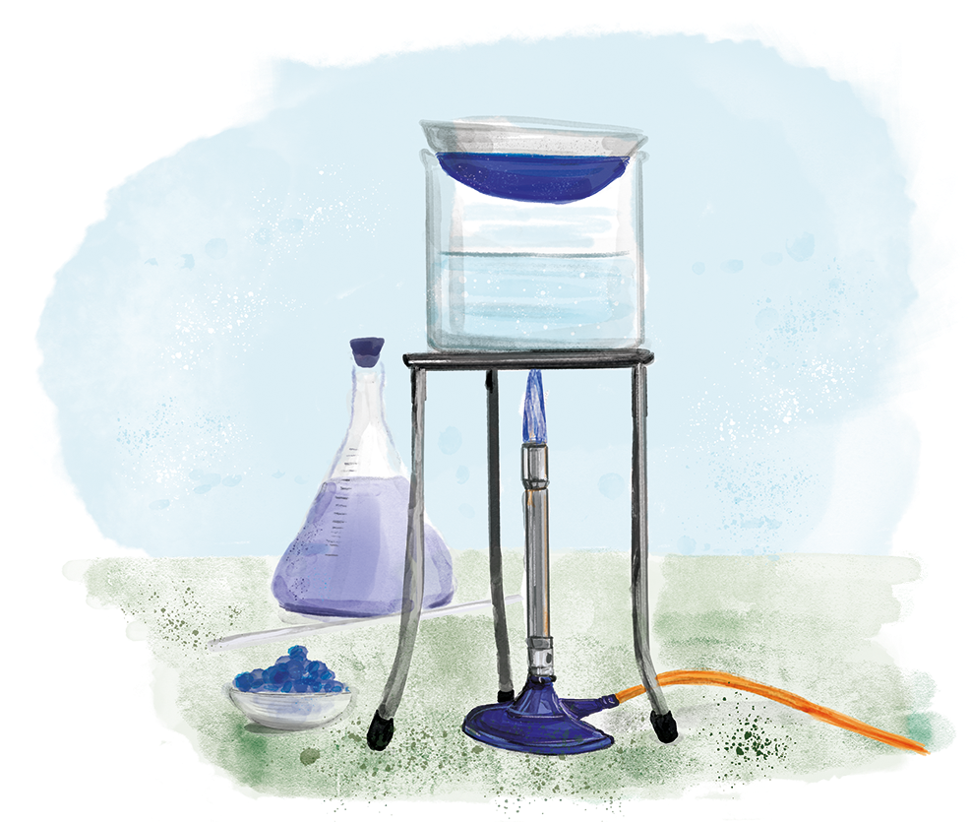
C4.3.10
15/11/2023
Acids, Alkalis and Neutralisation
C4.3.1 Prior Knowledge Review
C4.3.2 (HT) Introducing the Mole
C4.3.3 (HT) Mole Calculations
C4.3.4 PKR: Concentration
C4.3.5 TIF: Calculating Concentration
C4.3.6 TIF: Calculating an Unknown Concentration
C4.3.7 (HT) Amounts of Substances in Equations
C4.3.8 (HT) Limiting Reactants
C4.3.9 PKR: Reactions of Acids
C4.3.10 Acids, Alkalis and Neutralisation
C4.3.11 TIF: Acid-Alkali Titration
C4.3.12 TIF: Acid-Alkali Titration Analysis
C4.3.13 TIF: Titration Calculations
C4.3.14 (HT) Strong and Weak Acids
C4.3.15 TIF: Volumes of Gases
Notes:
Big idea: Reactions rearrange matter
In this lesson students will focus on the ions produced by acids and alkalis in solution and how they are involved in a neutralisation reaction. They will review the production of salts in neutralisation reactions and determine formulae of ionic salts.
Suggested Hook:
If I want to know the pH of a solution to 1 decimal place, what should I use?

Slide 6

Following this lesson, students will be able to:
Use the pH scale to identify acids and alkalis
Identify ions produced by acids and alkalis in solution
Describe what happens in a neutralisation reaction
Key Words:
acid
alkali
neutralisation
hydrogen ion
hydroxide ion
Notes:
Guidance:
See unit overview document and planning guidance to see how these objectives are typically assessed at GCSE, including examples of what students should be able to do following this lesson.
Planning for different needs:
The learning objectives given on this slide are suggested based on the most common requirements for exams, however they can be adapted based on the needs of different classes.
For best practice, the unit preparation booklet should be used to determine the appropriate focus of lessons within the unit.
While it is not possible to explicitly split content into levelled grades, we recommend that lesson objectives can be classified as critical, core or stretch.
Critical: the content or skill is essential for all students to be able to progress.
Core: the content or skill is important for students to progress, but other opportunities may be available to revisit it.
Stretch: the content or skill may not be essential for all students but is important for students aiming for the highest grades.
Key skill: this is a crucial skill being developed in this unit as part of the skill mapping
C4.3.10 Lesson Objectives:
Critical: Use the pH scale to identify acids and alkalis
Critical: Identify ions produced by acids and alkalis in solution
Core: Describe what happens in a neutralisation reaction

Slide 7
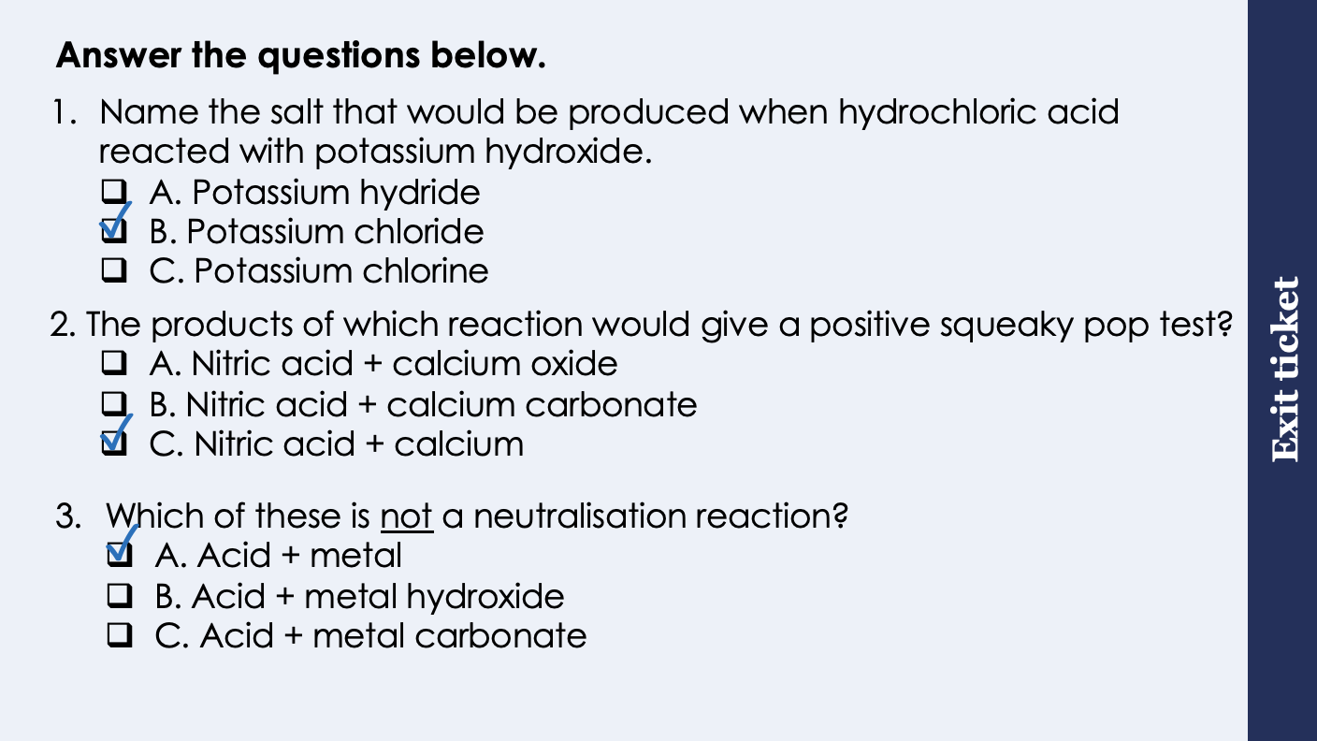
This is the fix-it portion of the lesson
The fix-it is an opportunity to respond to gaps in knowledge, especially those identified by the pre-unit quiz.
The teacher should customise this slide as needed, to facilitate
reteach, explanation, demonstration or modelling of ideas and concepts that students have not yet grasped or have misunderstood.
practise answering specific questions or of key skills.
redrafting or improving previous work.
Notes:
Purpose: to spend time on any gaps identified in previous learning from exit ticket.
Fix-it guidance from previous exit ticket:
Q1. Answer: B
If students answer A, they know that a compound ends ‘ide’ but have not recalled that hydrochloric acid makes chloride salts. If students answer C, they recognise that chlorine is involved but not the key part that it is the chloride ion in the compound. To fix-it, review the rules for naming salts and give students lots of practice.
Q2. Answer: C
If students answer A, it shows they are not clear on the reaction between an acid and a base. If students answer B, they have confused the squeaky pop test and the limewater test. To fix-it, review what the squeaky pop test and the limewater test detect the presence of and give students practice of identifying from reactants which pairs will produce positive results.
Q3. Answer: A
If students answer B or C, it shows that students are not clear on the meaning of a neutralisation reaction. This will be addressed in the next lesson. To fix-it, review the definition of a neutralisation reaction and show students the ions involved.

Slide 8
The pH Scale and indicators
The pH scale is a measure of the acidity or alkalinity of a solution.
pH can be measured using a pH probe or Universal Indicator.
Universal Indicator can give an approximate pH based on the colour it turns in different solutions.
A solution with pH 7 is neutral.
Aqueous solutions of acids have pH values of less than 7.
Aqueous solutions of alkalis have pH values greater than 7.
Notes:
Suggested exposition:
The pH scale ranges from 0-14 and is the measure of the acidity or alkalinity of a solution.
What is a solution?
A solute dissolved in a solvent.
In this topic, we will be talking about a lot of different solutions. Remember the state symbol aq means dissolved in solution. The aq shows that the solvent is water.
The pH of a solution can be measured using Universal Indicator (either UI paper or solution) or a pH probe.
What might be an advantage of using UI over a pH probe?
It is a common chemical so is easily available.
What might be an advantage of using a pH probe over UI?
A pH probe can give a more precise value for pH, often to a decimal place. Universal indicator provides a colour that can be referenced against a chart, but this is more subjective than a straightforward numerical value, as people can judge colour differently. This means that Universal indicator can give an approximate pH value.
So what do the different pH values mean?
What is the pH of a neutral solution?
7.
What colour does UI turn when added to a neutral solution?
Green.
What is the pH of an acidic solution?
Less than 7, so between 0 and 6.9.
What colour does UI turn when added to an acidic solution?
Red/orange.
What is the pH of an alkaline solution?
Greater than 7, so between 8 and 14.
What colour does UI turn when added to an alkaline solution?
Purple/blue.

Slide 9
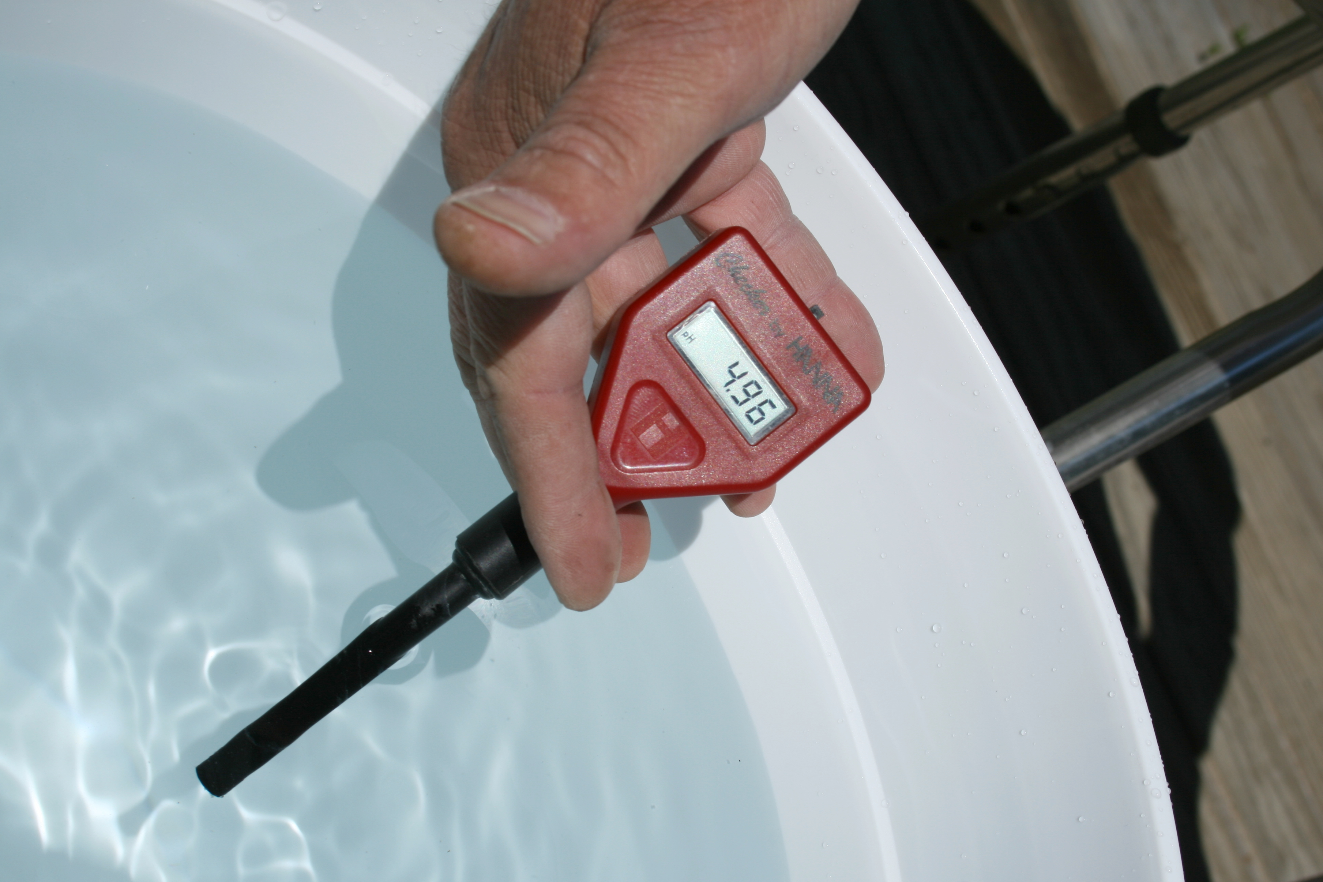
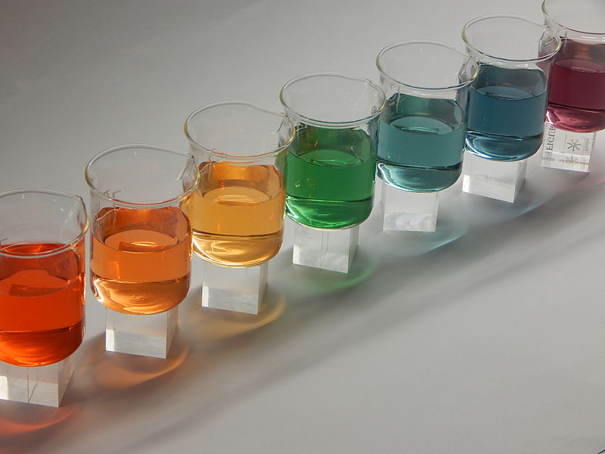
The pH scale and indicators
pH probe
Universal indicator
The number gives indication of pH
The colour gives an indication of pH
Notes:
pH probe image: https://commons.wikimedia.org/wiki/File:2009-03-30_Red_pH_meter_reads_4.96.jpg
universal indicator colours image: https://commons.wikimedia.org/wiki/File:Skala_boja_2.JPG

Slide 10
What are Acids and Alkalis? The tables below shows common acids and alkali that can be found in the laboratory.
Common Acids | Chemical Formula
Hydrochloric Acid | HCl
Nitric Acid | HNO₃
Sulfuric Acid | H₂SO₄
Common Alkalis | Chemical Formula
Sodium Hydroxide | NaOH
Potassium Hydroxide | KOH
Calcium Hydroxide | Ca(OH)₂
What similarities and differences can you see in the chemical formulae?
Notes:
Recap from C2.1 and C2.2.
Suggested script:
The words ‘alkali’ and ‘base’ are sometimes used to mean the same thing, however there is a difference. A base is a substance that can react with acids and neutralise them. Bases are usually: metal oxides, such as copper oxide, metal hydroxides, such as sodium hydroxide, or metal carbonates, such as calcium carbonate.
Many bases are insoluble - they do not dissolve in water.
However, if a base does dissolve in water, we can call it an alkali. Most alkalis are soluble metal hydroxides.
Note: Students will need to know the formulae of these common laboratory acids and alkalis.
What do each of the three acids and alkalis have in common?
The acids all contain Hydrogen (H) and the alkalis all contain an OH (hydroxide).

Slide 11
What are Acids and Alkalis?
Acids produce hydrogen (H⁺) ions in aqueous solutions.
HCl (aq) → H⁺ (aq) + Cl⁻ (aq)
HNO₃ (aq) → H⁺ (aq) + NO₃⁻ (aq)
H₂SO₄ (aq) → 2H⁺ (aq) + SO₄²⁻ (aq)
Alkalis produce hydroxide (OH⁻) ions in aqueous solutions.
NaOH (aq) → Na⁺ (aq) + OH⁻ (aq)
KOH (aq) → K⁺ (aq) + OH⁻ (aq)
LiOH (aq) → Li⁺ (aq) + OH⁻ (aq)
Notes:
Suggested exposition:
So what exactly are acids and alkalis?
Acids are substances that produce hydrogen ions (H+) in aqueous solutions. This means that when they are in solution, they can split into their ions.
Different acids split into their ions to different extents, which we will look at in a later lesson (HT only).
For example, when hydrochloric acid is in solution, it produces the hydrogen ion and the chloride ion. Same with nitric acid, it produces the hydrogen ion and the nitrate ion, and sulfuric acid produces two hydrogen ions and the sulfate ion.
Alkalis produce hydroxide ions (OH-) in aqueous solutions. For example, sodium hydroxidein solution produces positive lithium ions and hydroxide ions.

Slide 12
Acid and Alkali: Neutralisation
Acid + alkali → salt + water
This is a neutralisation reaction:
Acid
Alkali
→
water
+
+ salt
H⁺ (aq)
+
OH⁻ (aq)
→
H₂O (l)
Notes:
Suggested exposition:
When acids and alkalis react, this is an example of a neutralisation reaction.
This is because the hydrogen ion from the acid reacts with the hydroxide ion from the alkali to produce a water molecule.
We are looking at the formation of just one water molecule, but in reality it would be millions and billions of ions forming molecules.
This can be represented by the equation:
H+ + OH- → H2O
The hydrogen ions are aq because they are in solution, as are the hydroxide ions. Water is represented with the liquid state symbol because it cannot be in a solution of itself!

Slide 13
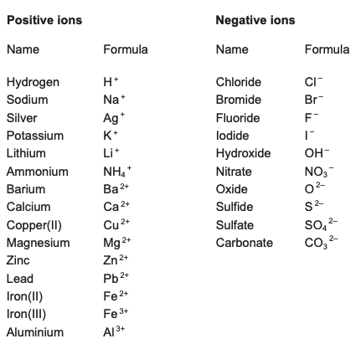
Salts
Hydrochloric acid makes chloride salts.
Acid + alkali → salt + water
Sulfuric acid makes sulfate salts.
Nitric acid makes nitrate salts.
What salt would be formed from a reaction between calcium hydroxide and hydrochloric acid?
Calcium chloride
Using the list of ions, determine the formula of this salt.
CaCl₂
What salt would be formed from a reaction between potassium hydroxide and sulfuric acid?
Potassium sulfate
Using the list of ions, determine the formula of this salt.
K₂SO₄
Notes:
Suggested exposition:
So we know that the reaction between an acid and an alkali produces water because the hydrogen ions from the acid react with the hydroxide ions from the alkali to form water molecules. The other product of this reaction is a salt.
Remember a salt is just any compound made from the reaction between an acid and a metal. In this case, the metal comes from the metal hydroxide.
Can we remember the rules for naming salts?
The name of the metal ion comes first, followed by the type of salt based on the acid it was formed from.
What kind of salts does hydrochloric acid make?
Chlorides
What kind of salts does sulfuric acid make?
Sulfates
What kind of salts does nitric acid make?
Nitrates
In the exam (and in most chemistry labs) we are also given this list of common ions, separated into the positive and negative ions. We can use these formulae to determine the chemical formula of a salt based on the reactants that were used to make it.
This takes us back to the formation of ions from atoms to obtain full outer electron shells.
What salt would be formed from a reaction between calcium hydroxide and hydrochloric acid?
Calcium chloride
Using the list of ions, what would the formula of this salt be?
Calcium is a 2+ ion and chloride is a 1- ion. This means that we will need two chloride atoms to each accept one electron from calcium. This gives calcium chloride the chemical formula CaCl₂.
What salt would be formed from a reaction between potassium hydroxide and sulfuric acid?
Potassium sulfate
Using the list of ions, what would the formula of this salt be?
Potassium is a 1+ ion and sulfate is a 2- ion. This 2- refers to the whole of the SO₄ unit. This means that we will need two potassium atoms to each donate one electron to sulfate. This gives potassium sulfate the chemical formula K₂SO₄.
Note: a more difficult example (barium nitrate) is included in the I/We/You section

Slide 14




Which statements do you agree with?
The higher the pH, the more acidic a solution
Neutralisation is when an acid is broken down
A neutralisation reaction always produces a salt
Acids reacting with metals are an example of neutralisation
Notes:
Expected Answers:
Blue (incorrect): This si a wording one that is good to check with students, still avoiding using the word strong. The higher the pH, the less acidic a solution is.
Yellow (incorrect): Neutralisation involves the hydrogen and hydroxide ion, it is not just about the acid being broken down.
Green (correct)
Pink (incorrect): This is a common misconception. Acid+ metal is a displacement reaction, not a neutralisation reaction. In this lesson, you can show that this is because there is no hydroxide ion present.
Suggested guidance:
Talk tasks can be used in a variety of ways to suit the particular needs of the students you are teaching. Through exchanging views with others, students develop their understanding of the science beyond what could be achieved individually.
Science classrooms that successfully integrate talk have the following features:
Science talk is a regular feature of lessons and is woven into classroom activities.
Students are paired or grouped strategically by the teacher to ensure productive interaction. This might take into consideration the students’ proficiency of the English language, how encouraging they might be to peers and their attainment in the topic. It’s a good idea to consider these pairings in the class seating plan.
Students are encouraged and supported to talk, but are not forced to talk.
The teacher should take on the role of a facilitator, engaging with conversations where necessary and encouraging or steering the conversation where needed.
Students are encouraged to use the language they have to express their ideas (e.g., everyday language, imperfect English, native language), but also to incorporate science specific terminology where this is more accurate or has been taught.
6. Scientifically inaccurate ideas are not dismissed by the partner or teacher; open discussion and further investigation are relied on to help students construct ideas that support them to progress in their scientific understanding.
7. Guidelines for behaviour during talk tasks are explicit and frequently reviewed. Rules for students might be:
Listen carefully to your partner
Take turns talking.
Speak one at a time, without interrupting.
Politely agree or disagree and explain why.
Politely point out if your partner has used a scientific word incorrectly, if they have explained the science incorrectly, or if there is a more accurate way to describe something.
If confused, ask questions.
Stay focused on the discussion topic.
Respond to one another.

Slide 15
Is this statement correct?
Neutralisation is a redox reaction
Notes:
This is not correct. There is no transfer of electrons, so it is not a redox reaction. The hydrogen ion and hydroxide ion form water and the metal ion from the acid produces the salt without its oxidation state changing.
Suggested guidance:
Talk tasks can be used in a variety of ways to suit the particular needs of the students you are teaching. Through exchanging views with others, students develop their understanding of the science beyond what could be achieved individually.
Science classrooms that successfully integrate talk have the following features:
Science talk is a regular feature of lessons and is woven into classroom activities.
Students are paired or grouped strategically by the teacher to ensure productive interaction. This might take into consideration the students’ proficiency of the English language, how encouraging they might be to peers and their attainment in the topic. It’s a good idea to consider these pairings in the class seating plan.
Students are encouraged and supported to talk, but are not forced to talk.
The teacher should take on the role of a facilitator, engaging with conversations where necessary and encouraging or steering the conversation where needed.
Students are encouraged to use the language they have to express their ideas (e.g., everyday language, imperfect English, native language), but also to incorporate science specific terminology where this is more accurate or has been taught.
6. Scientifically inaccurate ideas are not dismissed by the partner or teacher; open discussion and further investigation are relied on to help students construct ideas that support them to progress in their scientific understanding.
7. Guidelines for behaviour during talk tasks are explicit and frequently reviewed. Rules for students might be:
Listen carefully to your partner
Take turns talking.
Speak one at a time, without interrupting.
Politely agree or disagree and explain why.
Politely point out if your partner has used a scientific word incorrectly, if they have explained the science incorrectly, or if there is a more accurate way to describe something.
If confused, ask questions.
Stay focused on the discussion topic.
Respond to one another.

Slide 16
Name the salts that would be produced from the following pairs of reactants:
sodium chloride
NaCl
Sodium hydroxide + hydrochloric acid→
Potassium hydroxide + nitric acid →
Lithium hydroxide + sulfuric acid →
Barium hydroxide + hydrochloric acid →
Sodium hydroxide + sulfuric acid→
Lithium hydroxide + nitric acid →
potassium nitrate
KNO₃
lithium sulfate
Li₂SO₄
barium chloride
BaCl₂
sodium sulfate
Na₂SO₄
lithium nitrate
LiNO₃
Stretch: determine their formulae
What would the other product be in each of these reactions?
Water

Slide 17
Drill
State the pH of neutral solutions.
State the pH of acidic solutions.
State the pH of alkaline solutions.
Describe two ways of measuring pH.
Name the ion that acids produce in aqueous solutions.
Name the ion that alkalis produce in aqueous solutions.
State the general equation for the reaction between an acid and an alkali.
Name the type of salts formed from hydrochloric acid.
Name the type of salts formed from sulfuric acid.
Name the type of salts formed from nitric acid.
Notes:
Purpose: This is a knowledge drill. The purpose of this is to check that the critical knowledge is secure before pupils move onto independent practice.
Suggested guidance: There are a range of ways this could be done depending on time and ability range of the class:
Mini whiteboards
As full sentences in exercise books
As short answers in exercise books
In the pupil workbook
As pair talk
As cold call

Slide 18
Drill answers
7
Less than 7 (0-6)
Greater than 7 (8-14)
Universal Indicator or a pH probe
H⁺
OH⁻
Acid + alkali → salt + water
Chlorides
Sulfates
Nitrates
Notes:
Purpose: This is a knowledge drill. The purpose of this is to check that the critical knowledge is secure before pupils move onto independent practice.
Suggested guidance: There are a range of ways this could be done depending on time and ability range of the class:
Mini whiteboards
As full sentences in exercise books
As short answers in exercise books
In the pupil workbook
As pair talk
As cold call

Slide 19
I: determining chemical formula
A student reacts hydrochloric acid with lithium hydroxide.
What salt would be produced in this reaction?
Lithium chloride
What would the other product(s) of this reaction be?
Water
Write this as a word equation.
Hydrochloric acid + lithium hydroxide → lithium chloride + water
Use the data sheet to determine the chemical formula of the salt.
Li⁺ Cl⁻
LiCl
How is the water formed?
The hydrogen ion(s) from the acid react with the hydroxide ion(s) from the alkali to produce water molecules.
Notes:
Purpose: The I-We-You section aims to support pupils to build skills that they most commonly need when answering questions associated with this knowledge in the assessment. This section is also used to interleave other content we expect pupils to know at this stage of their education in order that they build a big picture of the science they are learning.
For the ‘I’ activity, the teacher should model how to answer the question. They can do this by narrating their thinking process aloud, and making links to learning earlier in the lesson explicit.
For the ‘we’ activity, the teacher and students work though a similar example together, in order to prepare students to be able to answer a similar question independently.
Opportunities for the ‘you’ activity – independent practise – occur in the activity portion of the lesson once the student is secure enough to process independently.

Slide 20
We: determining chemical formula
A student reacts potassium hydroxide with sulfuric acid.
What salt would be produced in this reaction?
potassium sulfate
What would the other product(s) of this reaction be?
Water
Write this as a word equation.
Sulfuric acid + potassium hydroxide → potassium sulfate + water
Use the data sheet to determine the chemical formula of the salt.
K⁺ SO₄²⁻
K₂SO₄
Notes:
Purpose: The I-We-You section aims to support pupils to build skills that they most commonly need when answering questions associated with this knowledge in the assessment. This section is also used to interleave other content we expect pupils to know at this stage of their education in order that they build a big picture of the science they are learning.
For the ‘I’ activity, the teacher should model how to answer the question. They can do this by narrating their thinking process aloud, and making links to learning earlier in the lesson explicit.
For the ‘we’ activity, the teacher and students work though a similar example together, in order to prepare students to be able to answer a similar question independently.
Opportunities for the ‘you’ activity – independent practise – occur in the activity portion of the lesson once the student is secure enough to process independently.

Slide 21
You: determining chemical formula
A student reacts nitric acid with barium hydroxide.
What salt would be produced in this reaction?
Barium nitrate
What would the other product(s) of this reaction be?
Water
Write this as a word equation.
Nitric acid + barium hydroxide → barium nitrate + water
Use the data sheet to determine the chemical formula of the salt.
Ba²⁺ NO₃⁻
Ba(NO₃)₂
Notes:
Purpose: The I-We-You section aims to support pupils to build skills that they most commonly need when answering questions associated with this knowledge in the assessment. This section is also used to interleave other content we expect pupils to know at this stage of their education in order that they build a big picture of the science they are learning.
For the ‘I’ activity, the teacher should model how to answer the question. They can do this by narrating their thinking process aloud, and making links to learning earlier in the lesson explicit.
For the ‘we’ activity, the teacher and students work though a similar example together, in order to prepare students to be able to answer a similar question independently.
Opportunities for the ‘you’ activity – independent practise – occur in the activity portion of the lesson once the student is secure enough to process independently.

Slide 22
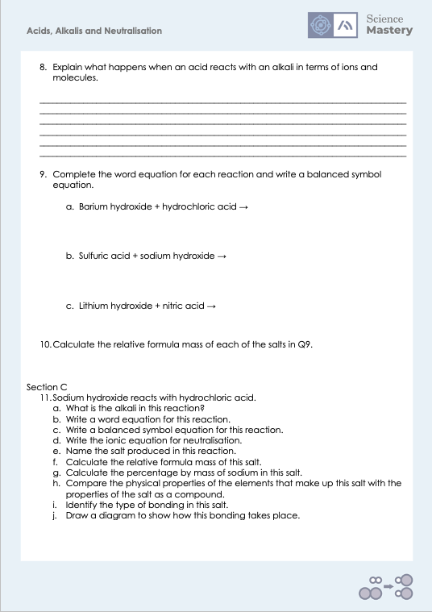
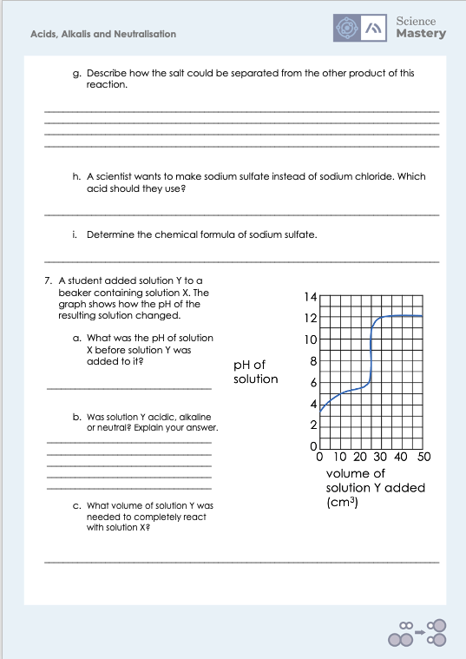
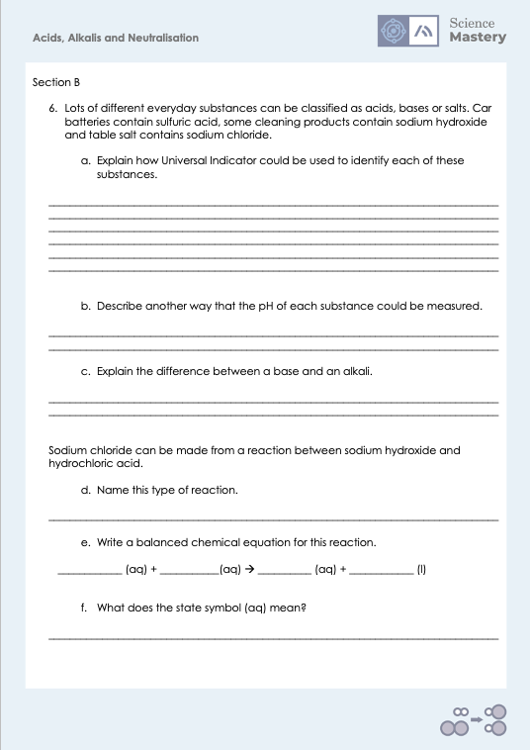
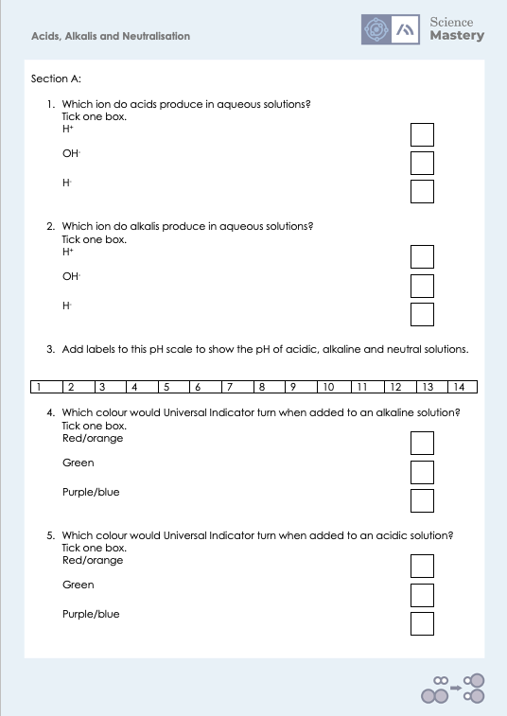
Activity

Slide 23
Answers
1. H⁺
2. OH⁻
Neutral
Acidic
Alkaline
3.
1 | 2 | 3 | 4 | 5 | 6 | 7 | 8 | 9 | 10 | 11 | 12 | 13 | 14
4. Purple/blue
5. Red/orange
6a.
Add (a few drops of) Universal indicator to a solution of each
UI will turn purple/blue in alkaline solutions, this is the sodium hydroxide
UI will turn red/orange in acidic solutions, this is the sulfuric acid
UI will turn green in neutral solutions, this is the sodium chloride solution
6b. Using a pH probe
6c. A base is a substance that can react with an acid to neutralise it. An alkali is a soluble base.

Slide 24
Answers
6d. Neutralisation
6e. NaOH (aq) + HCl (aq) → NaCl (aq) + H₂O (l)
6f. Dissolved in solution
6g. Sodium chloride is a soluble salt so would have to be separated from the water by evaporation or distillation. Water has a lower boiling point so would turn into a gas at a lower temperature when the mixture is heated, leaving behind the sodium chloride.
6h. Sulfuric acid
6i. Na₂SO₄

Slide 25
Answers
7a. 3.5
7b. Solution Y was alkaline. When it was added to solution X, the pH of the solution increased.
7c. 25 cm³
8. Hydrogen ions from the acid react with hydroxide ions from the alkali to produce water molecules.
9a.
Barium hydroxide + hydrochloric acid → barium chloride + water
Ba(OH)₂ + 2 HCl → BaCl₂ + 2 H₂O
9b.
Sulfuric acid + sodium hydroxide → sodium sulfate + water
H₂SO₄ + 2 NaOH → Na₂SO₄ + 2 H₂O
10.
M_{r} BaCl₂ = 208
M_{r} Na₂SO₄ 142
M_{r} LiNO₃ = 69
9c.
Lithium hydroxide + nitric acid → lithium nitrate + water
LiOH + HNO₃ → LiNO₃ + H₂O

Slide 26
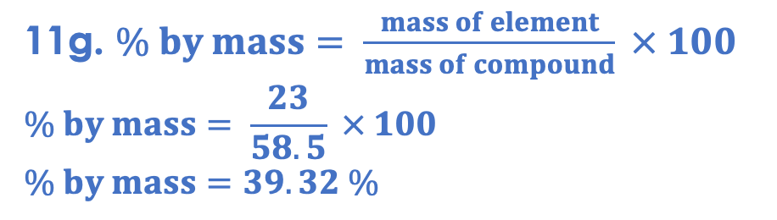
Answers
11a. sodium hydroxide
11b. sodium hydroxide + hydrochloric acid → sodium chloride + water
11c. NaOH + HCl → NaCl + H₂O
11d. H⁺ (aq) + OH⁻ (aq) → H₂O (l)
11e. sodium chloride
11f. 23+35.5 = 58.5
11g. $\% by mass= \frac{mass of element}{mass of compound} × 100$
$$\% by mass= \frac{23}{58.5} × 100$$
$$\% by mass=39.32 \%$$
11h. Sodium is an alkali metal, so is shiny and soft. Chlorine is a yellow/green gas. Sodium chloride is a white powder.
11i. ionic

Slide 27
Answers
11j.
+
-
×
×
×
×
×
×
×
×
×
×
×
Na⁺
Cl⁻

Slide 28
Answer the questions below.
Identify the ion that is produced by acids in aqueous solutions.
A. H⁺
B. OH⁻
C. H₂O
✓
Name the salt that would be produced when sulfuric acid reacts with lithium hydroxide?
A. Lithium hydride
B. Lithium sulfide
C. Lithium sulfate
✓
What is the correct ionic equation when an acid is neutralised by an alkali?
A. H₂O → H⁺ + OH⁻
B. H + OH → H₂O
C. H⁺ + OH⁻ → H₂O
✓
Notes:
Q1. Answer: A
If students answer B, they are not clear on the ions in solution produced by acids and alkalis. If students answer C, they have recognised water from the neutralisation reaction, but not the correct ion. To fix-it, review the ions produced by acids and alkalis in solution and the ionic equation in a neutralisation reaction.
Q2. Answer: C
If students answer A, it shows they have been confused by the hydroxide part of the name, which is a common mistake. If students answer B, they have recognised the sulfur element but not the correct name. To fix-it, review the formula for sulfuric acid and why it produces sulfates rather than sulfides.
Q3. Answer: C
If students answer A, they have got the equation the wrong way round. If students answer B, it shows that students have recognised the elements but not the key aspect that they are ions. To fix-it, review the definition of a neutralisation reaction and show students the ions involved.

Slide 29
Lesson C4.3.10
What was good about this lesson? | What can we do to improve this lesson?
Send us your feedback by clicking this link
or by emailing sciencemastery@arkonline.org
Thank you!

